Slide 1
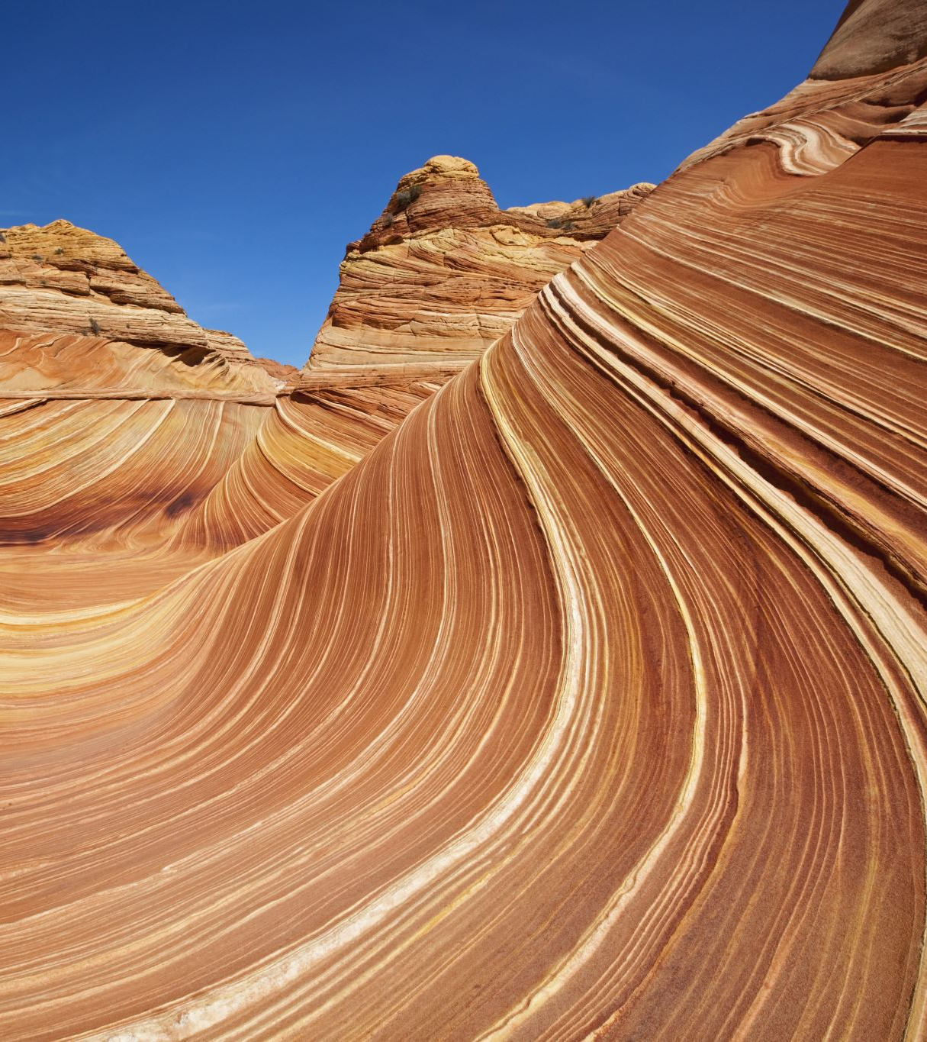
Weathering and Erosion
Chapter 5
Lesson 3

Slide 2

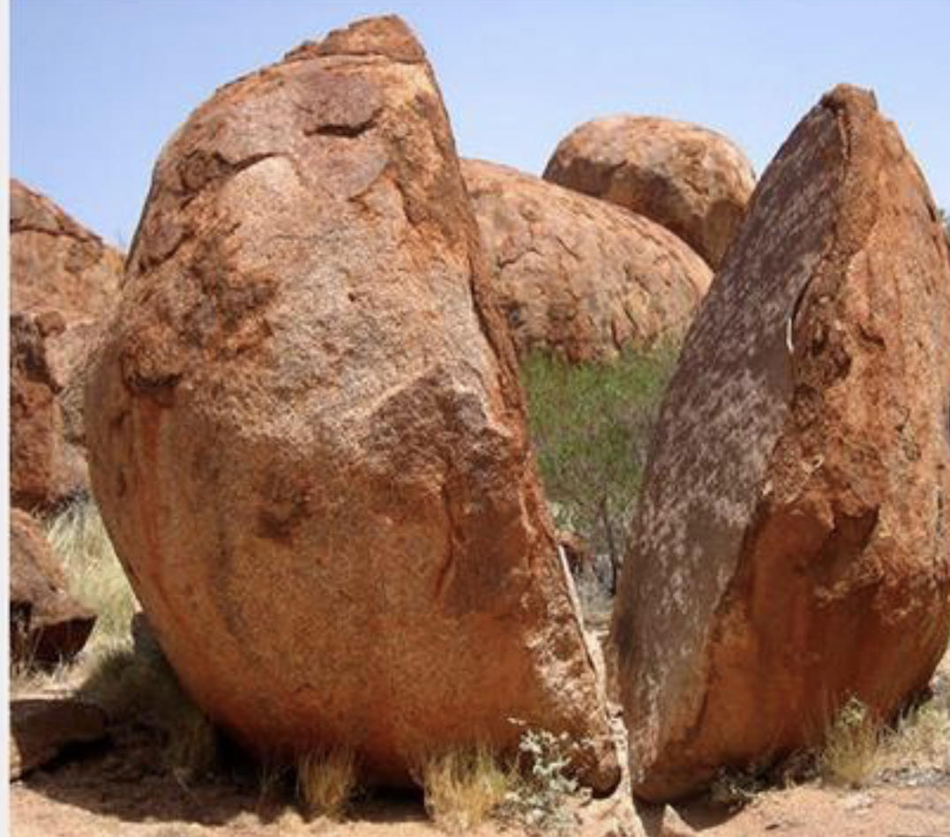
Please Do Now!!!!!
-Looking at this picture what do we think caused this boulder to break apart???
-Please write down your thoughts.
-If you get the correct answer Miss. Swisher will give you a dollar.

Slide 3
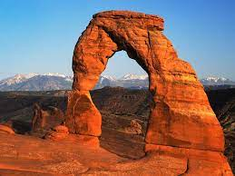
Weathering
-The slow process that breaks rocks into smaller pieces is called weathering
-Some causes of weathering are flowing water, rain, and wind.

Slide 4
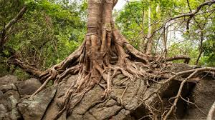
Physical Weathering
A rock is broken apart by physical weathering if the rock type does not change.

Slide 5
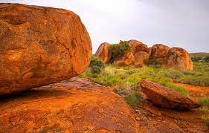
Chemical Weathering
Chemical Weathering changes what a rock is made of over time. If water and oxygen can weather iron. They can change iron into rust.

Slide 6
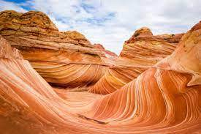
Erosion
The weathering and removal of rock from one place to another is called erosion.
This is an example of wind erosion!!!

Slide 7
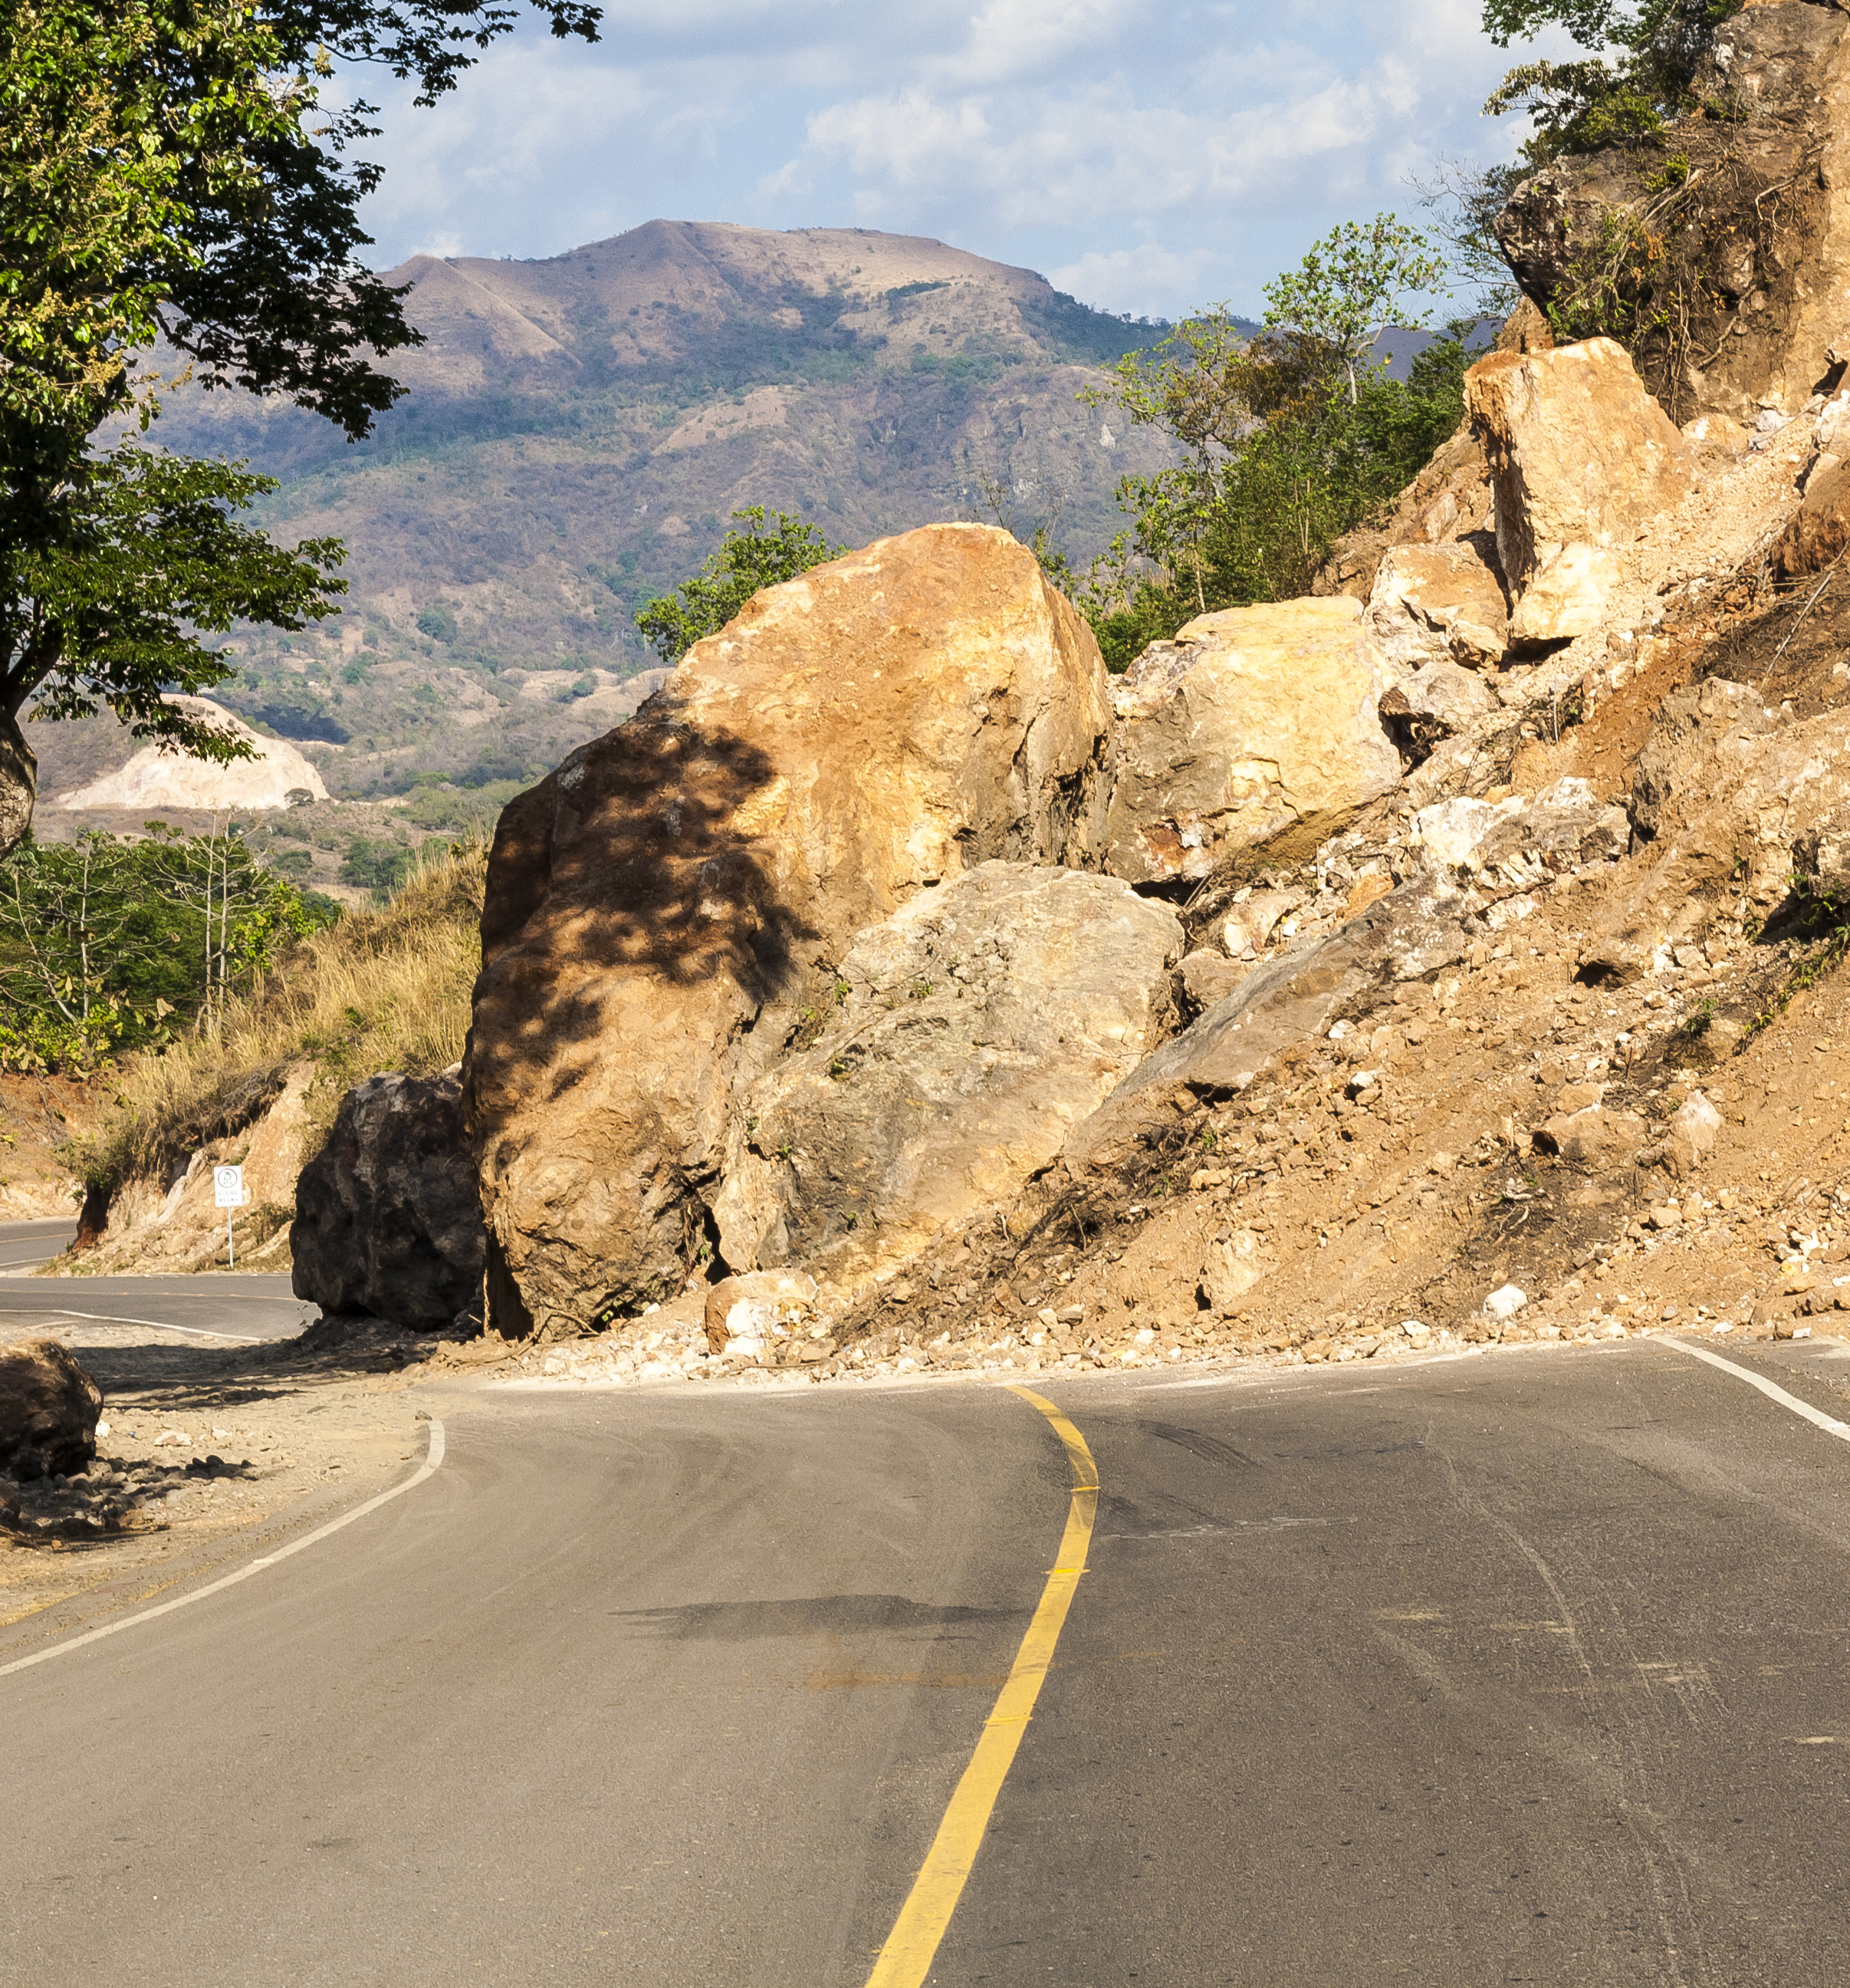
Gravity
Erosion can be caused by glaciers, wind, moving water, and gravity.
Gravity is an invisible force that pulls objects towards each other.

Slide 8
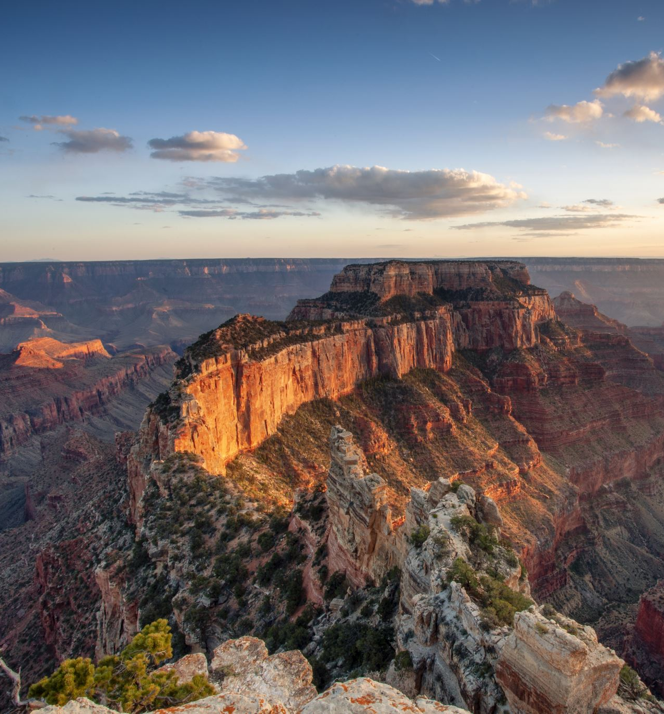
Grand Canyon
When the Colorado River eroded the land around the river in Arizona, the Grand Canyon was formed.

Slide 9
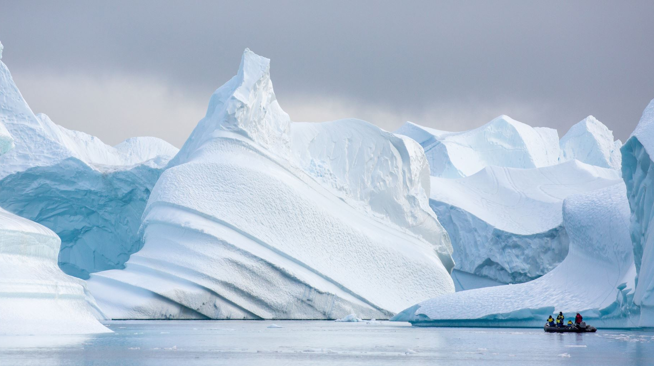
Glaciers
Glaciers form in very cold places as thick sheets of ice.

Slide 10
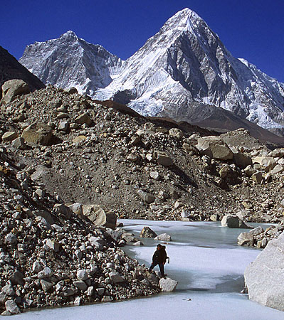
Glaciers
Deposits left behind by a glacier are called glacial debris and glacial till.

Slide 11
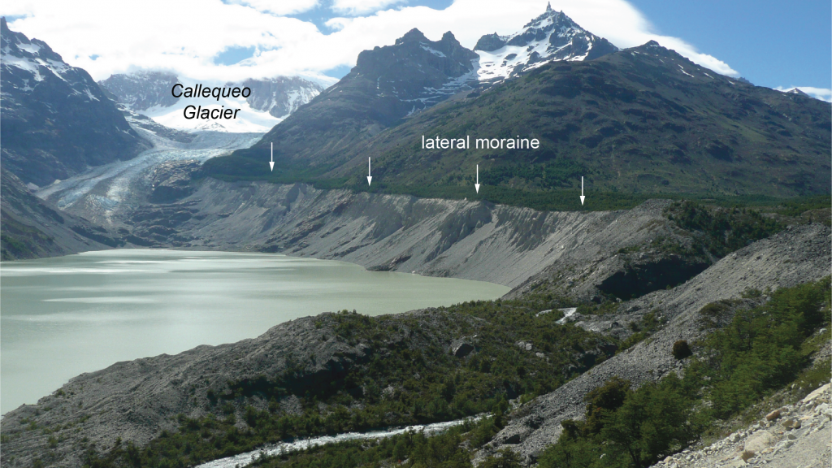
Moraines
The mounds that form where till builds up are called moraines.

Slide 12
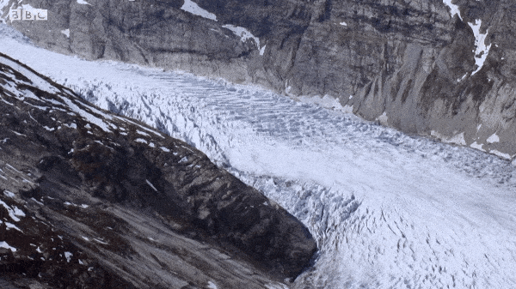
Flow
As the weight of the overlying ice increases, the glacier begins to flow.

Slide 13
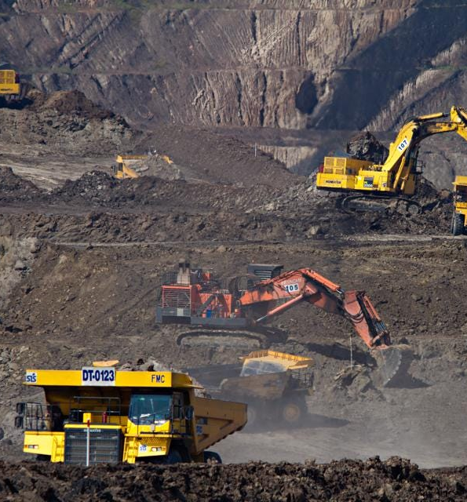
Mining
People change the land by mining it to get minerals, metals or fuels.

Slide 14
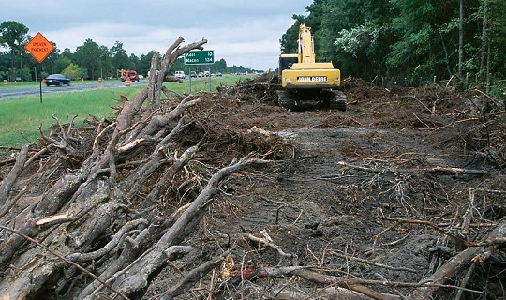
Changes
Most processes change land slowly, but people can make faster changes.

Slide 15

3-2-1
List 3
List three facts you learned today.
List 2
List two questions you have about what you learned today.
List 1
List the one thing you found most interesting.

